Slide 1
Backtracking name itself suggests that we are going back and coming forward; if it satisfies the condition, then return success, else we go back again. It is used to solve a problem in which a sequence of objects is chosen from a specified set so that the sequence satisfies some criteria.

Slide 2
When to use a Backtracking algorithm?
When we have multiple choices, then we make the decisions from the available choices. In the following cases, we need to use the backtracking algorithm:
A piece of sufficient information is not available to make the best choice, so we use the backtracking strategy to try out all the possible solutions.
Each decision leads to a new set of choices. Then again, we backtrack to make new decisions. In this case, we need to use the backtracking strategy.

Slide 3
How does Backtracking work?
Backtracking is a systematic method of trying out various sequences of decisions until you find out that works. Let's understand through an example.
We start with a start node. First, we move to node A. Since it is not a feasible solution so we move to the next node, i.e., B. B is also not a feasible solution, and it is a dead-end so we backtrack from node B to node A.

Slide 4
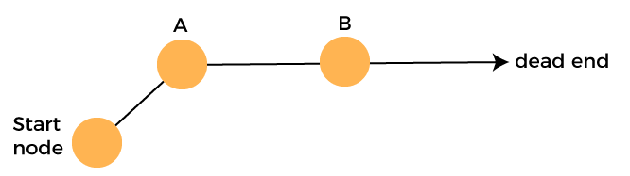

Slide 5
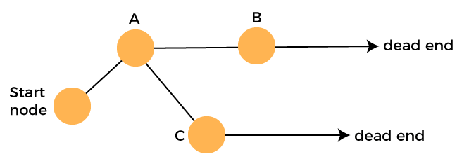
Suppose another path exists from node A to node C. So, we move from node A to node C. It is also a dead-end, so again backtrack from node C to node A. We move from node A to the starting node.

Slide 6
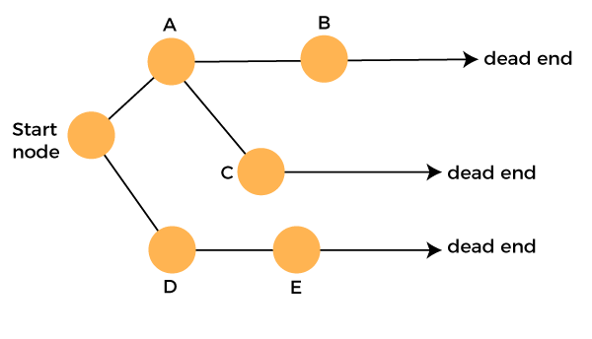
Now we will check any other path exists from the starting node. So, we move from start node to the node D. Since it is not a feasible solution so we move from node D to node E. The node E is also not a feasible solution. It is a dead end so we backtrack from node E to node D.

Slide 7
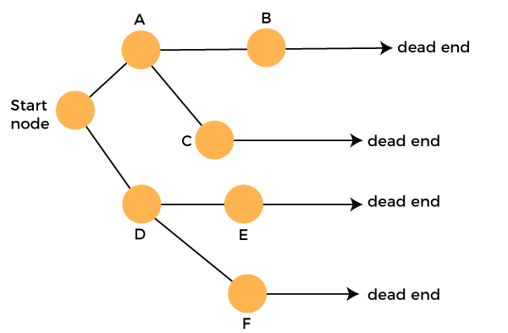
Suppose another path exists from node D to node F. So, we move from node D to node F. Since it is not a feasible solution and it's a dead-end, we check for another path from node F.

Slide 8
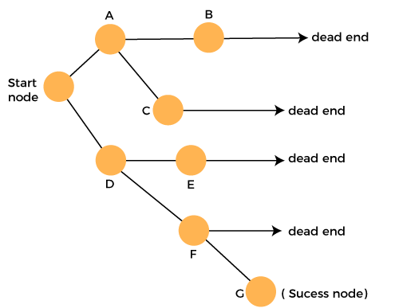
Suppose there is another path exists from the node F to node G so move from node F to node G. The node G is a success node.

Slide 9
The terms related to the backtracking are:
Live node: The nodes that can be further generated are known as live nodes.
E node: The nodes whose children are being generated and become a success node.
Success node: The node is said to be a success node if it provides a feasible solution.
Dead node: The node which cannot be further generated and also does not provide a feasible solution is known as a dead node.

Slide 10
Many problems can be solved by backtracking strategy, and that problems satisfy complex set of constraints, and these constraints are of two types:
Implicit constraint: It is a rule in which how each element in a tuple is related.
Explicit constraint: The rules that restrict each element to be chosen from the given set.

Slide 11
Applications of Backtracking
N-queen problem
Sum of subset problem
Graph coloring
Hamiliton cycle

Slide 12
4 - Queen's problem
In 4- queens problem, we have 4 queens to be placed on a 4*4 chessboard, satisfying the constraint that no two queens should be in the same row, same column, or in same diagonal.
The solution space according to the external constraints consists of 4 to the power 4, 4-tuples i.e., Si = {1, 2, 3, 4} and 1<= I <=4, whereas according to the internal constraints they consist of 4! solutions i.e., permutation of 4.

Slide 13
Backtracking Algorithm
1) Start in the leftmost column
2) If all queens are placed
return true
3) Try all rows in the current column.
Do following for every tried row.
a) If the queen can be placed safely in this row
then mark this [row, column] as part of the
solution and recursively check if placing
queen here leads to a solution.
b) If placing the queen in [row, column] leads to
a solution then return true.
c) If placing queen doesn't lead to a solution then
unmark this [row, column] (Backtrack) and go to
step (a) to try other rows.
3) If all rows have been tried and nothing worked,
return false to trigger backtracking.

Slide 14
Solution of 4 – queen’s with the help of backtracking
We can solve 4-queens problem through backtracking by taking it as a bounding function .in use the criterion that if (x1, x2, ……., xi) is a path to a current E-node, then all the children nodes with parent-child labelings x (i+1) are such that (x1, x2, x3, ….., x(i+1)) represents a chessboard configuration in which no queens are attacking.
So we start with the root node as the only live node. This time this node becomes the E-node and the path is (). We generate the next child. Suppose we are generating the child in ascending order. Thus the node number 2 is generated and path is now 1 i.e., the queen 1 is placed in the first row and in the first column.

Slide 15
Now, node 2 becomes the next E-node or line node. Further, try the next node in the ascending nodes i.e., the node 3 which is having x2 = 2 means queen 2 is placed in the second column but by this the queen 1 and 2 are on the same diagonal, so node 3 becomes dead here so we backtrack it and try the next node which is possible.
Here, the x2 = 3 means the queen 2 is placed in the 3rd column. As it satisfies all the constraints so it becomes the next live node.
After this try for next node 9 having x3 = 2 which means the queen 3 placed in the 2nd column, but by this the 2 and 3 queen are on the same diagonal so it becomes dead. Now we try for next node 11 with x3 = 4, but again the queens 2 and 3 are on the same diagonal so it is also a dead node.

Slide 16
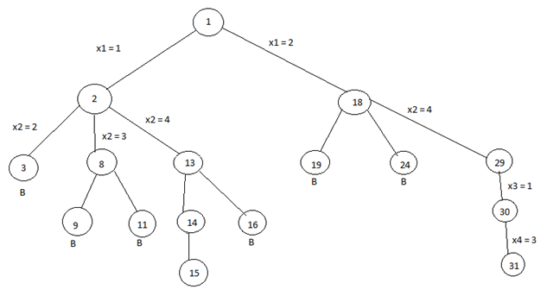

Slide 17
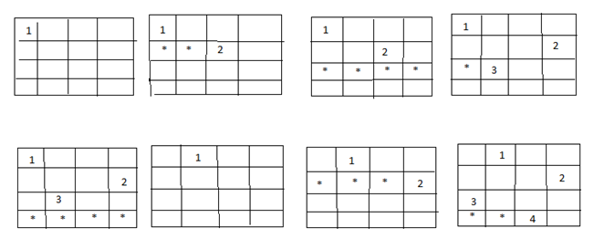
The B denotes the dead node.
We try for all the possible positions for the queen 3 and if not any position satisfy all the constraints then backtrack to the previous live node.

Slide 18
Now, the node13 become the new live node with x2 = 4, means queen 2 is placed in the 4th column. Move to the next node 14. It becomes the next live node with x3 = 2 means the queen 3 is placed in the 2nd column. Further, we move to the next node 15 with x4 = 3 as the live node. But this makes the queen 3 and 4 on the same diagonal resulting this node 15 is the dead node so we have to backtrack to the node 14 and then backtrack to the node 13 and try the other possible node 16 with x3 = 3 by this also we get the queens 2 and 3 on the same diagonal so the node is the dead node.

Slide 19
So we further backtrack to the node 2 but no other node is left to try so the node 2 is killed so we backtrack to the node 1 and try another sub-tree having x1 = 2 which means queen 1 is placed in the 2nd column.
Now again with the similar reason, nodes 19 and 24 are killed and so we try for the node 29 with x2 = 4 means the queen 2 is placed in the 4th column then we try for the node 30 with x3 = 1 as a live node and finally we proceed to next node 31 with x4 = 3 means the queen 4 is placed in 3rd column.
Here, all the constraints are satisfied, so the desired result for 4 queens is {2, 4, 1, 3}.

Slide 20
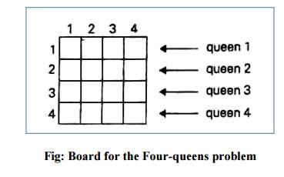

Slide 21
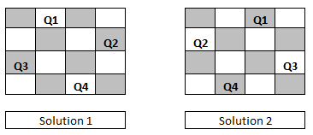

Slide 22
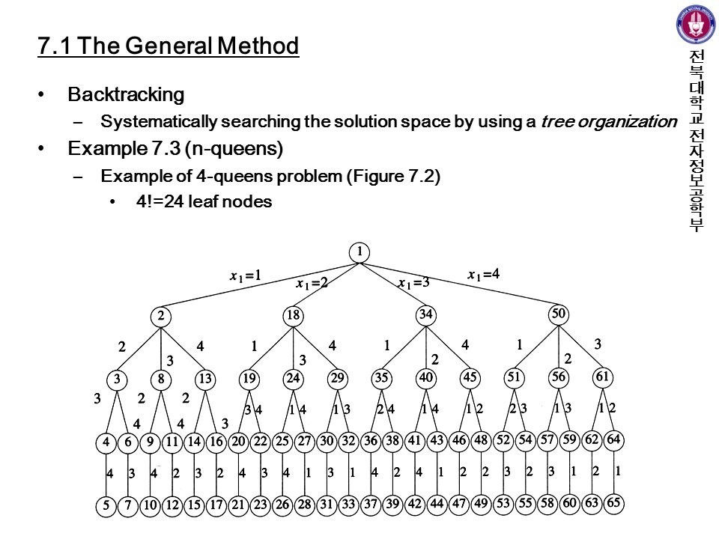

Slide 23
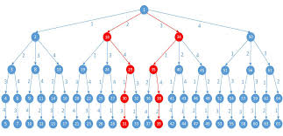

Slide 24
Thanks

